Slide 1
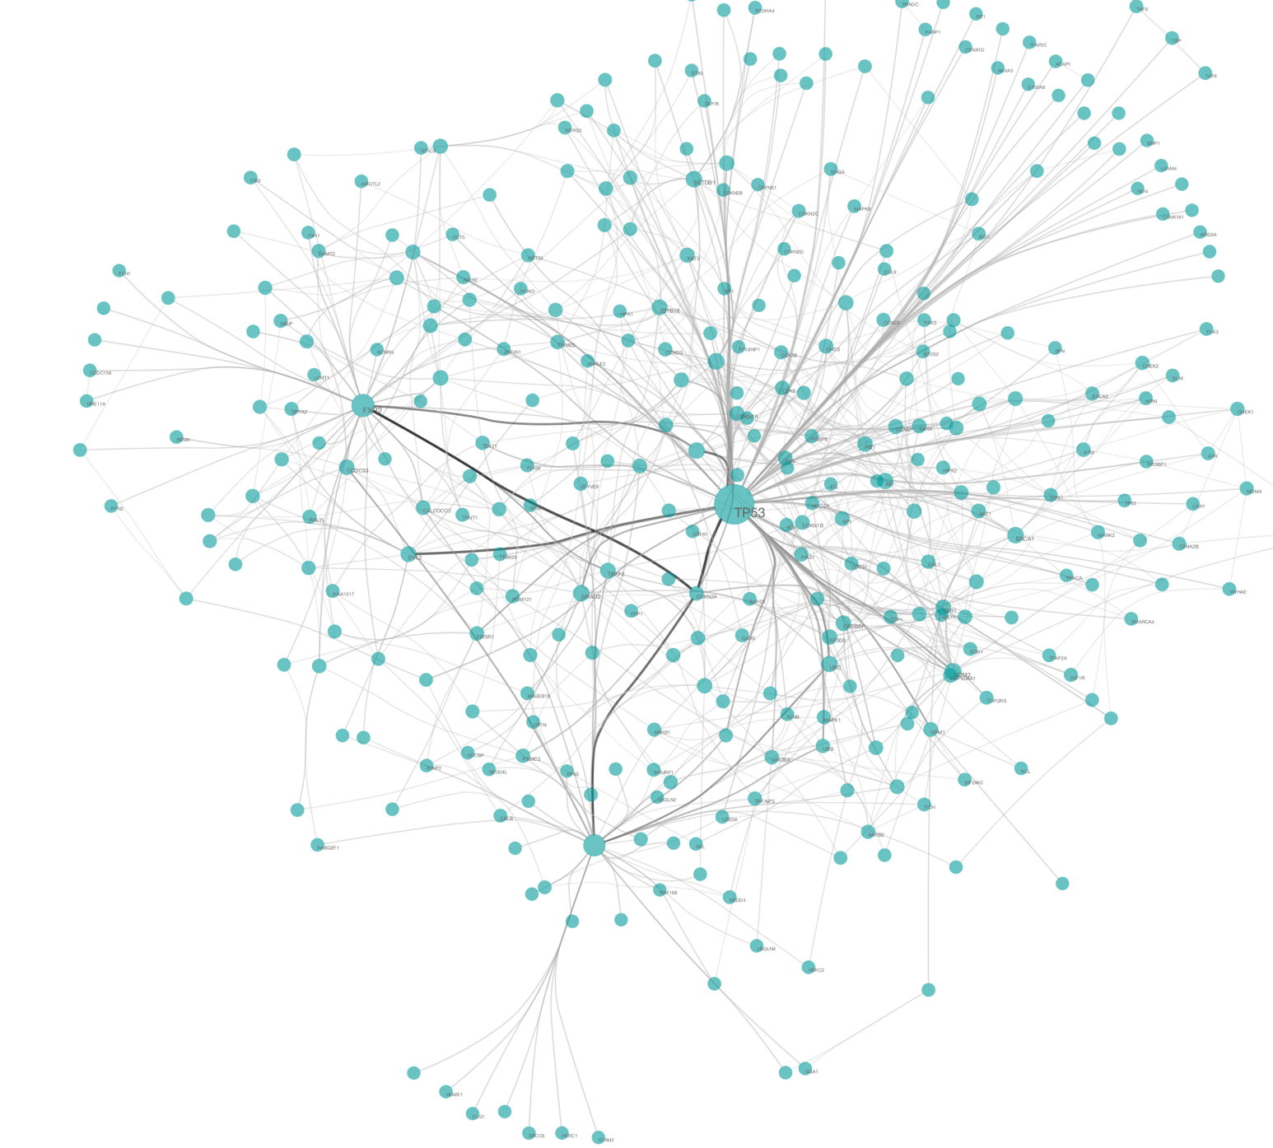
Biological Network Analysis
Hannah Carter
UCSD Department of Medicine
02/27/2018
hkcarter@ucsd.edu

Slide 2
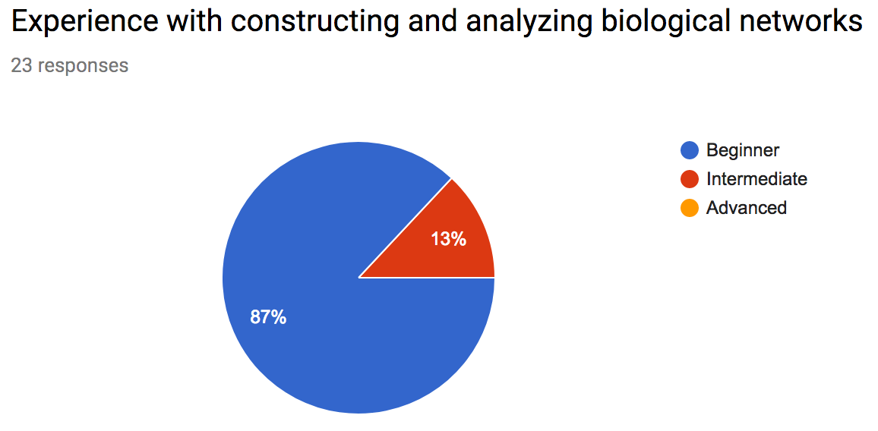
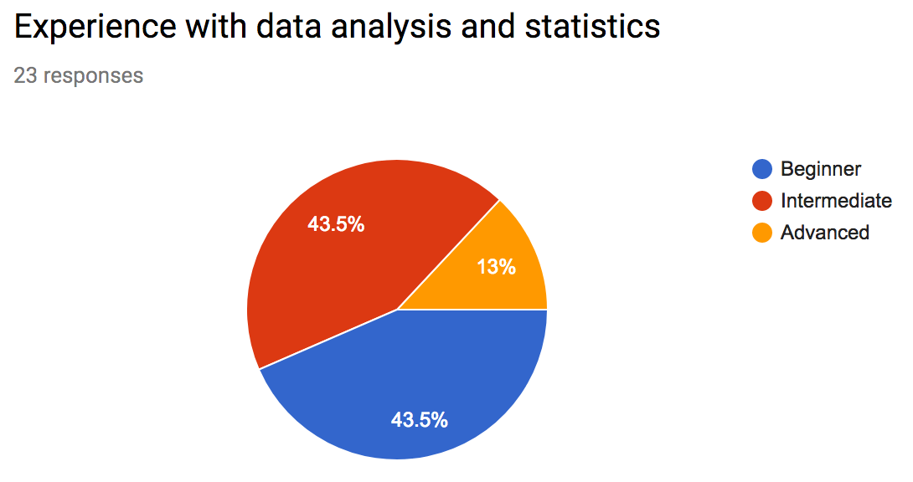
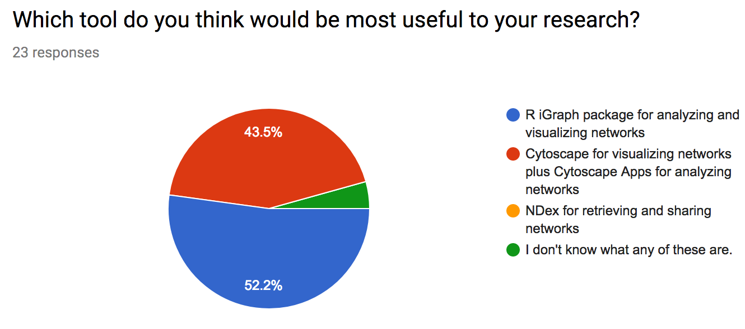
Class Survey: Thank You!

Slide 3
What the group would like to learn
“How to construct and analyze networks, as well as what questions can be asked and answered through them.”
“The logic behind it and the importance of it in the context of biological research”
“find a pathway in the network”
“How to accurately visualize and analyze networks”

Slide 4
Network Module Goals
Learn how networks can be created from high-throughput data
Understand how networks can be used to represent, analyze and interpret biological systems including:
Examples of biological networks
Common network statistics used for biological inference
How to generate a random distribution over a network
How networks have helped us understand the organization of biological systems and the implications of this organization for disease
Provide a basic computational toolkit for network visualization and analysis
Provide some examples of common algorithms for network construction and analysis
Describe sources of publicly available network data

Slide 5
Overview
Day 1: Introduction to networks
Why networks?
Network basics & examples of biological networks
What networks can teach us about biological systems
Challenges for biological network analysis
Introduction to Cytoscape and Ndex
Loading and visualizing networks
Day 2: Network analysis
Motif detection
Statistical hypothesis testing with networks
RNA seq data analysis

Slide 6
Please ask questions!

Slide 7
Why Networks?

Slide 8
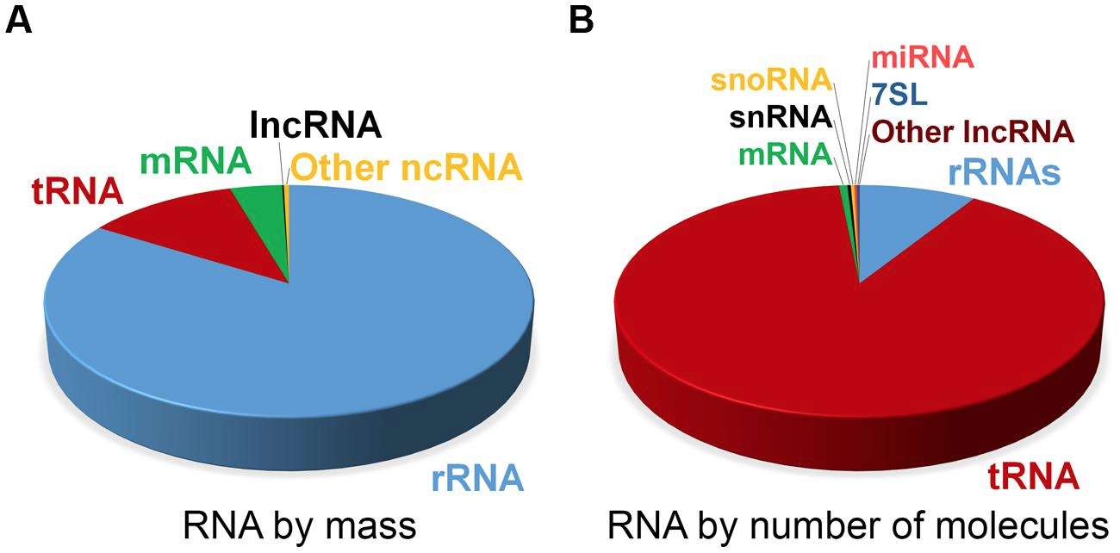
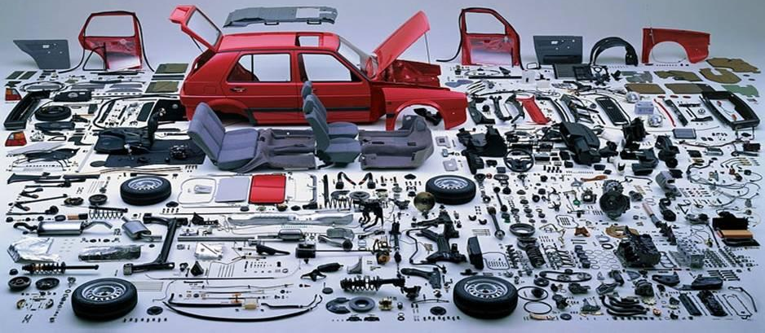
Biological Systems are Complex
Category | Homo Sapiens
Base pairs | ~ 6 billion
Chromosomes | 46
Protein coding genes | ~21,000
Proteins (including known splice isoforms) | ~92,179
Verified protein Interactions * | >240,000
Estimate of expected protein interactions ** | 650,000
Estimated proteomic diversity with SNPs and PTMs*** | 0.62 to 6.13 million
Non-coding RNAs | ??
****
Notes:
* Jones, Richard B., et al. "A quantitative protein interaction network for the ErbB receptors using protein microarrays." Nature 439.7073 (2006): 168.
** Stumpf, Michael PH, et al. "Estimating the size of the human interactome." Proceedings of the National Academy of Sciences 105.19 (2008): 6959-6964.
*** Ponomarenko, Elena A., et al. "The size of the human proteome: the width and depth." International journal of analytical chemistry 2016 (2016).
**** Palazzo, Alexander F., and Eliza S. Lee. "Non-coding RNA: what is functional and what is junk?." Frontiers in genetics 6 (2015): 2.

Slide 9

Complex Systems can Fail
Phenotype
Ferrari recall after 5 cars crash and spontaneously catch fire in 2010
Genotype
“Ferrari today said a flaw in the wheel arch on the rear of the £170,000 supercar is fitted with a special glue which is prone to melting. The fault brings the lining of the wheel-arch into contact with the hot exhaust pipe causing both the lining and the adhesive to heat up and ignite. As result of the fire the superheated aluminium body will subsequently melt.“
Mechanism
Notes:
http://www.dailymail.co.uk/news/article-1308061/Ferrari-recalls-cursed-supercar-FIVE-458-Italias-burst-flames.html

Slide 10
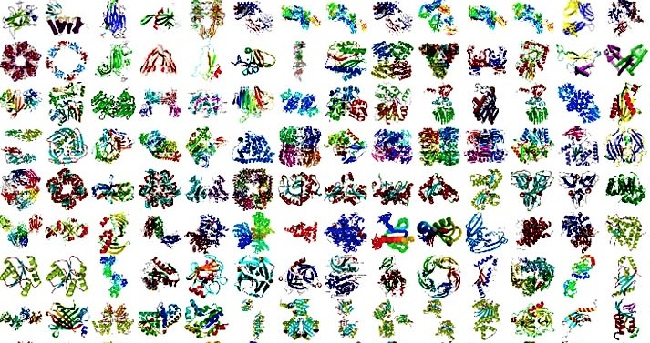
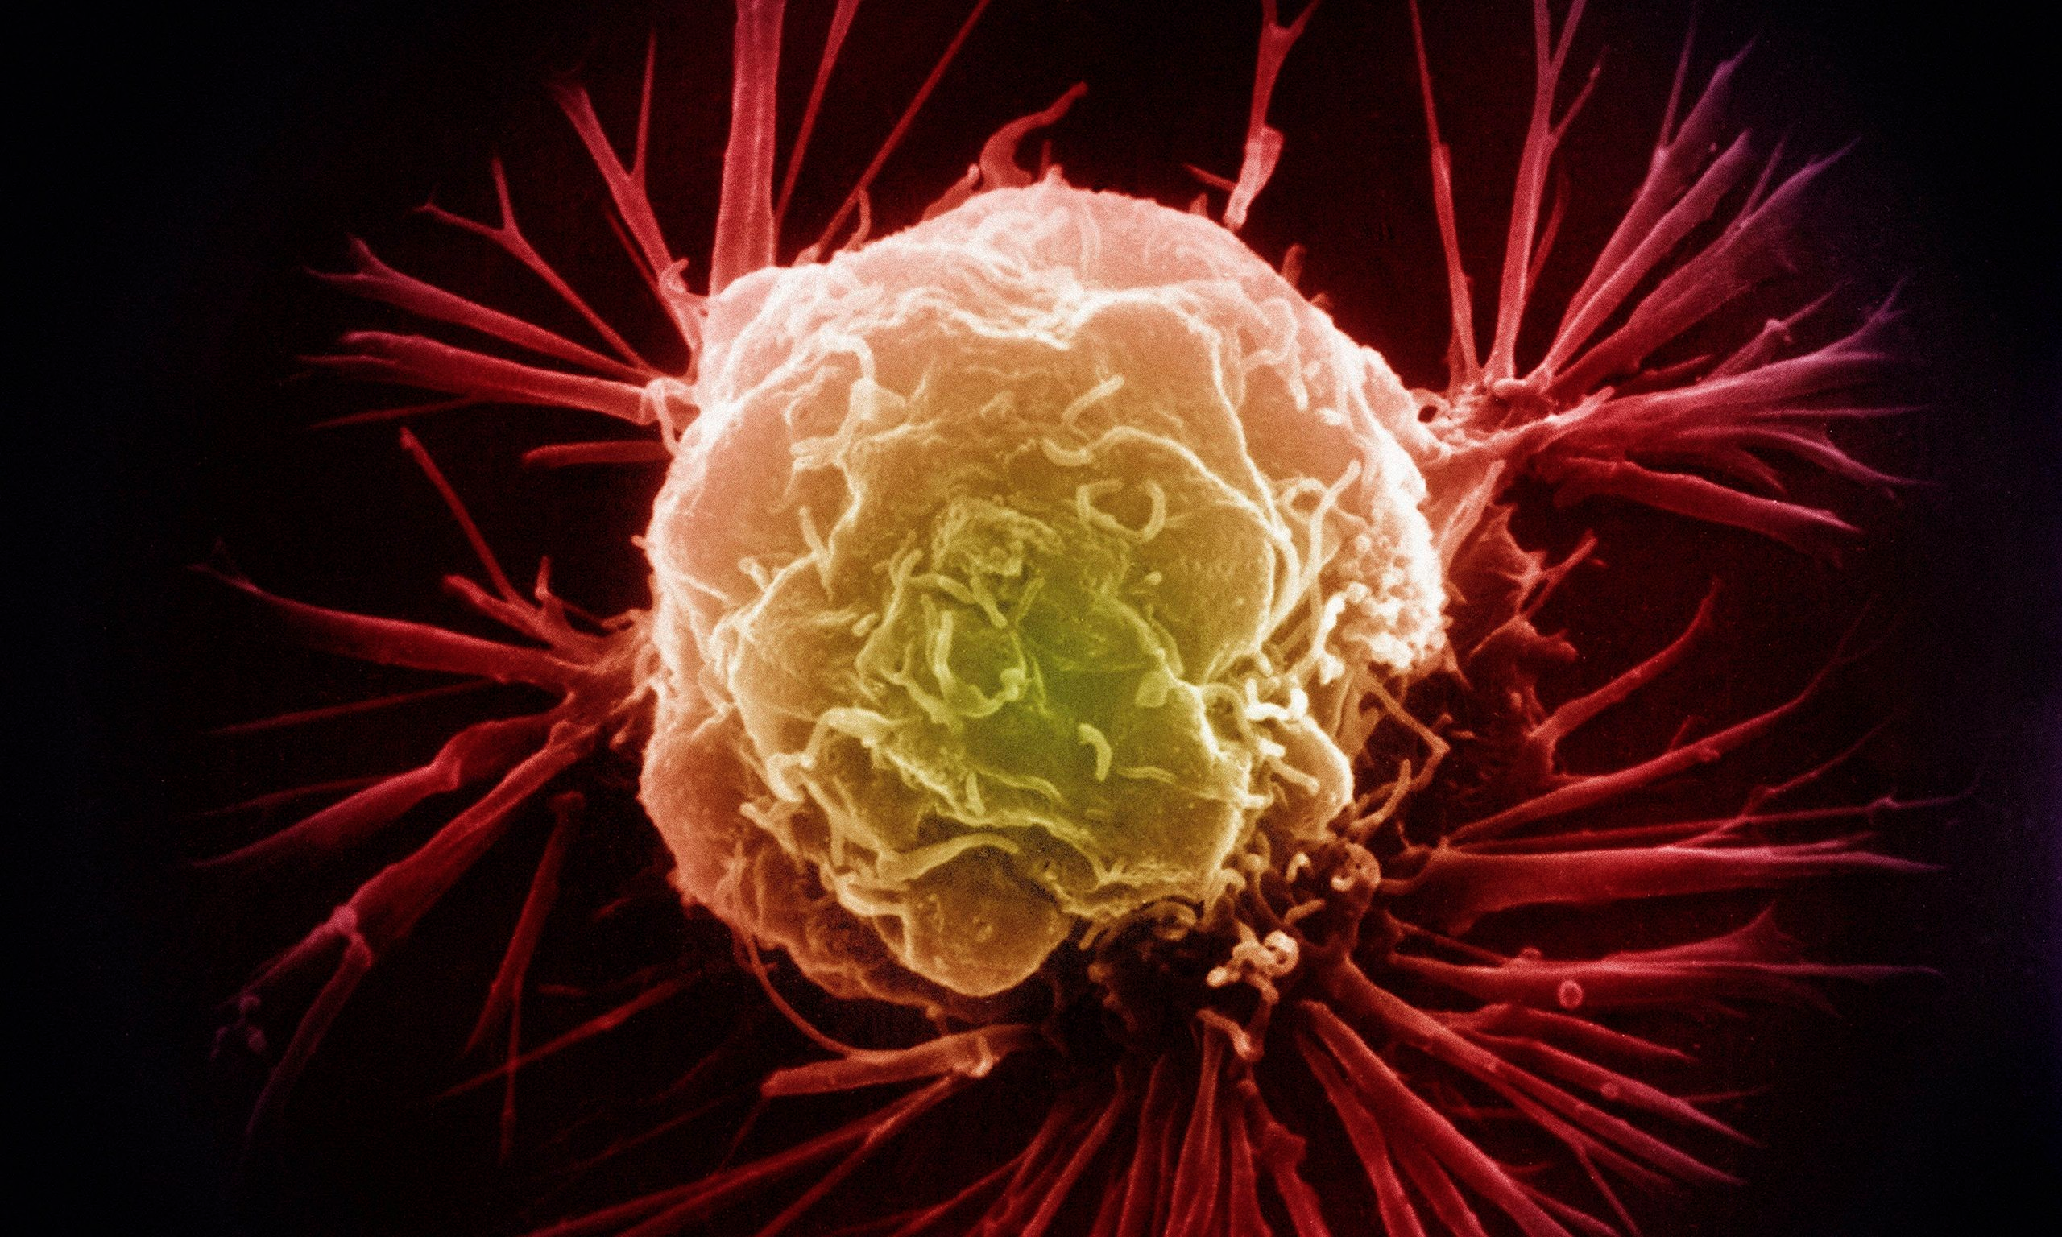

Why Networks?
Reductionist Biology
- Parts list
- Study each part individually
Systems biology
- Study behavior of the system
- Behavior arises from interactions among components
Networks as a tool for systems biology
- Explicitly model interactions
- Can be used to study complex behaviors of systems
- Are convenient tools for analyzing relationships in data generated from high throughput technologies
Notes:
The study of the interactions between the components of biological systems, and how these interactions give rise to the function and behavior of that system

Slide 11
Network Theory
Study of graphs as a representation of the relationships between discrete objects
Objects represented as nodes
Genes, proteins, enzymes, metabolites, drugs, diseases, …
Relationships represented as edges
Protein-protein interactions, enzyme-substrate pairs, co-expressed mRNAs, …

Slide 12
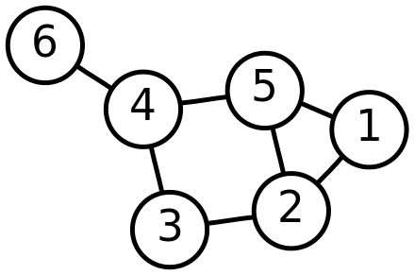
Networks are modeled by Graphs
G=(V,E)
V = vertices (or nodes)
E = edges (or links)
Subgraph – connected subset of G
G’ = (V’,E’)
V = {1, 2, 3, 4, 5, 6}
E = {{1, 2}, {1, 5}, {2, 3}, {2, 5}, {3, 4}, {4, 5 }, {4, 6}}

Slide 13
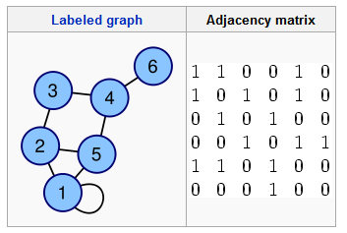
Creating Graphs from Data
Adjacency matrix
Can include edge weights in adjacency matrix
SIF format
1 1
1 2
1 5
2 3
2 5
3 4
4 5
4 6

Slide 14
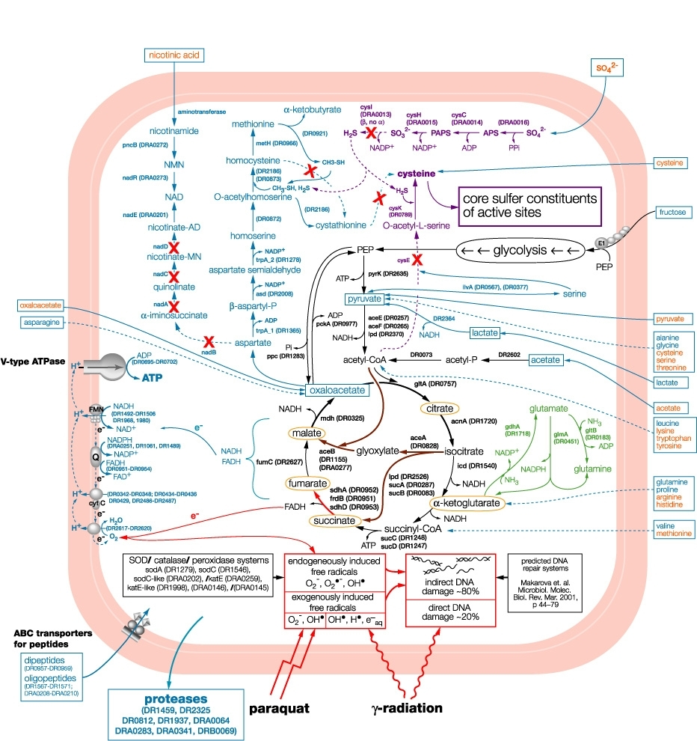
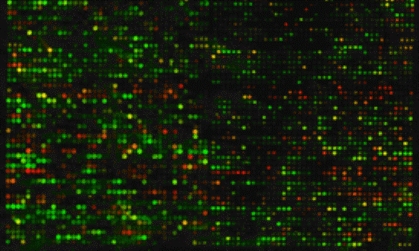
Creating Graphs from Data
Graphs that represent the known structure of biological systems
PPI networks
Gene regulatory networks from TF binding motifs
Metabolic networks
Graphs that are inferred from measured relationships between biological variables
Gene co-expression networks
Co-morbidity maps

Slide 15
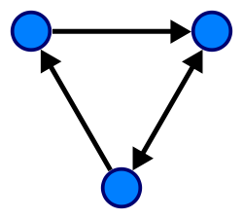
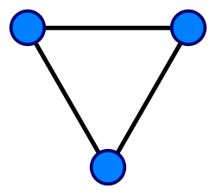
Versatility: Graphs can encode different types of information
Nodes can represent one type of entity or more
Bipartite graph
Edges can be directed or undirected (or mixed)
Directed when the direction of action or information flow is known
Different types of relationship
Example:
Enzymes and substrates
Examples:
Transcription factors and targets Protein-protein interactions

Slide 16
Could you encode a directed network with an adjacency matrix?
Could you encode a bi-partite network with an adjacency matrix?
 | A | B | C
1 | 1 | 0 | 1
2 | 1 | 1 | 0
3 | 0 | 0 | 1
1
A
2
B
3
C

Slide 17
Exercise: Creating simple graphs with R iGraph
Jupyter Notebook: Exercise 1

